Slide 1
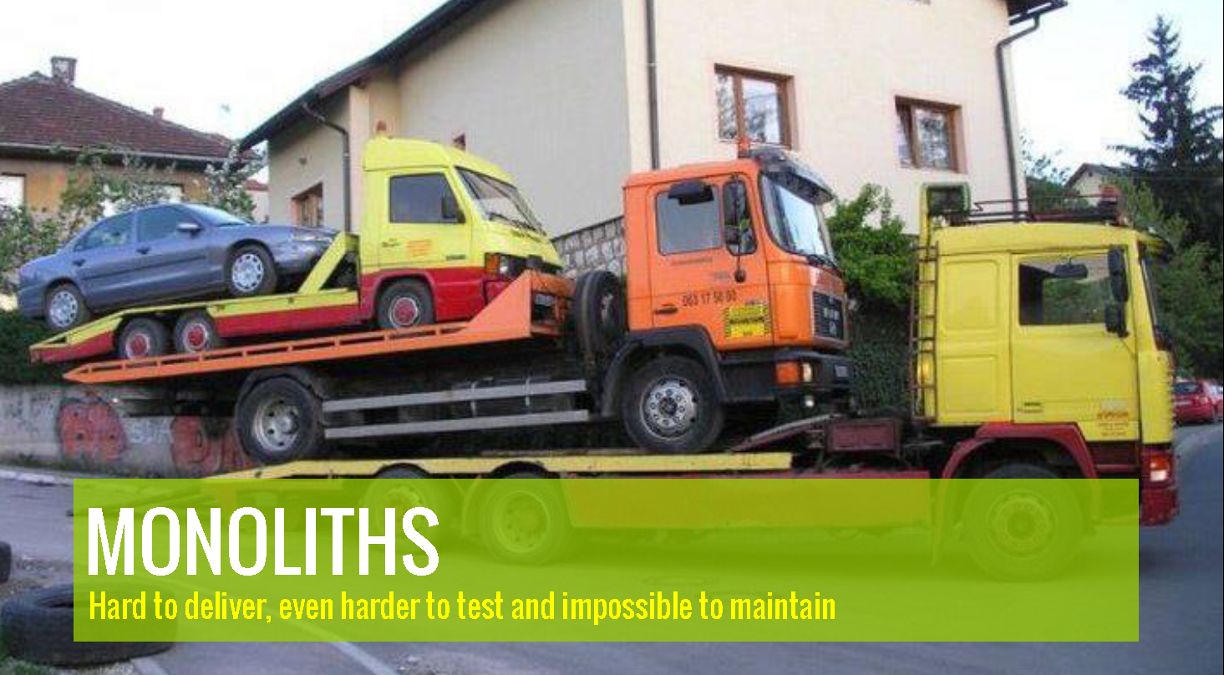
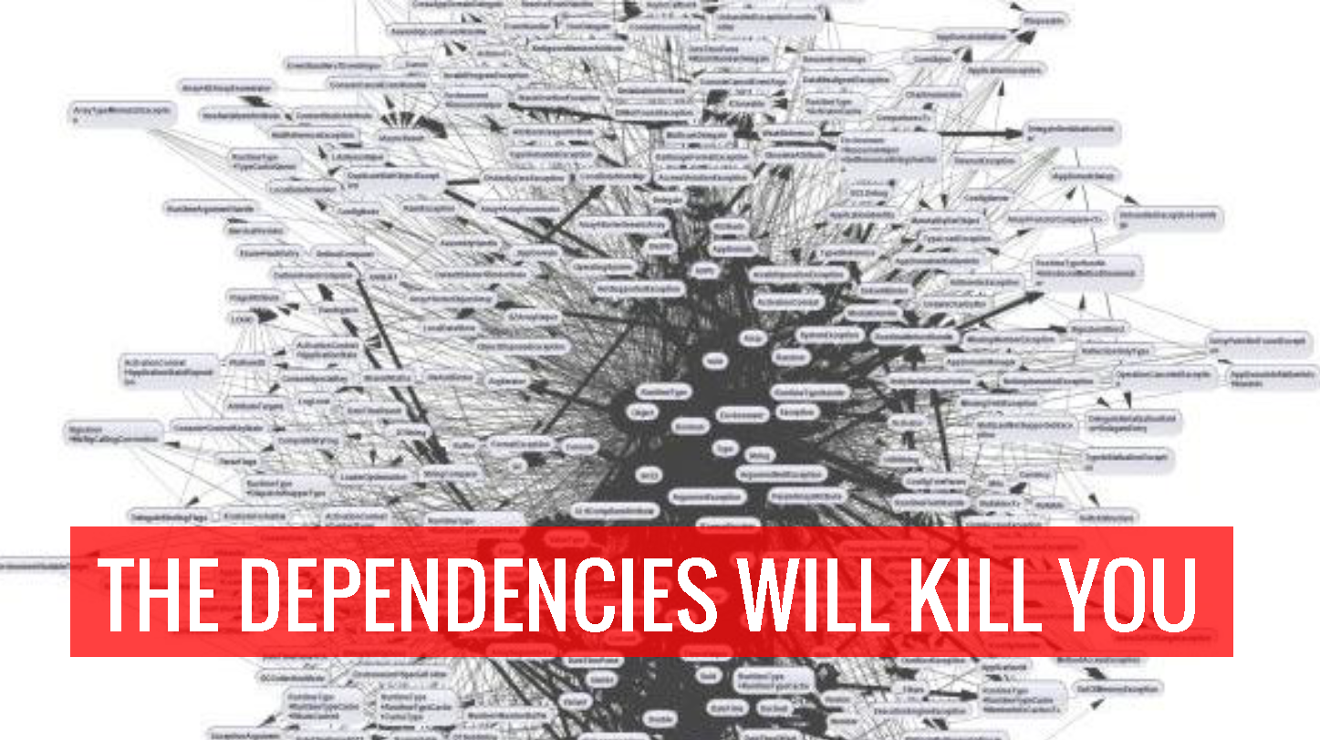
DOCKER – Build, ship and run

Slide 2
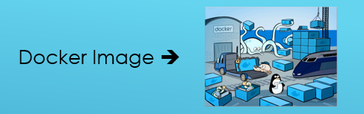


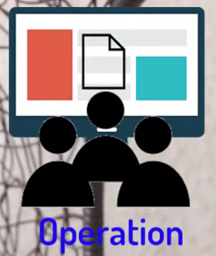
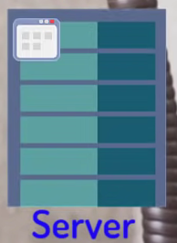
It is an ecosystem
Frameworks
Application
Dependencies & Libraries

Slide 3
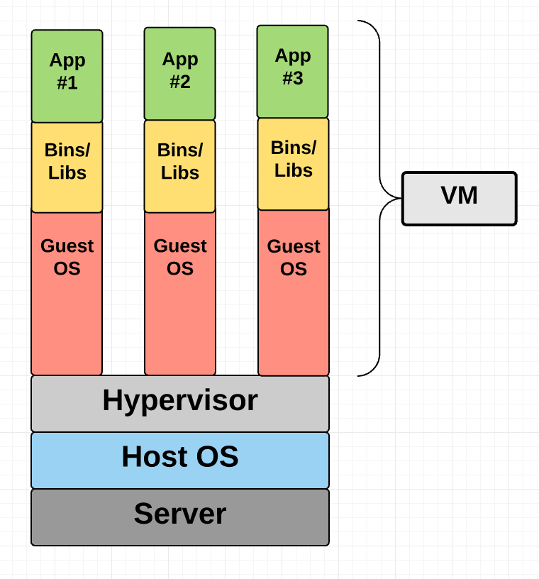
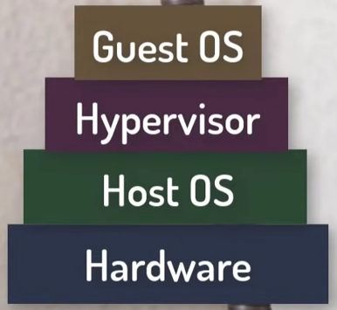
Virtual Machine

Slide 4
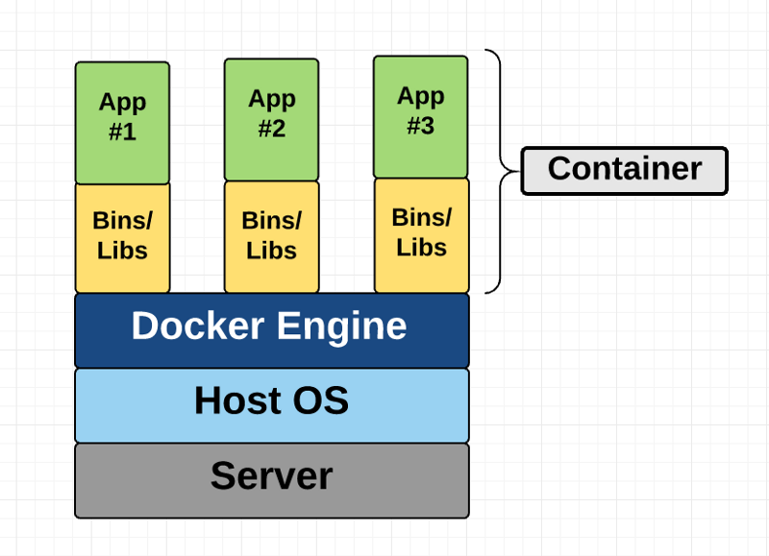
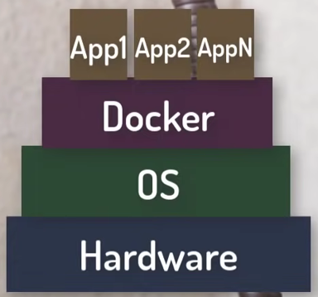
Container

Slide 5
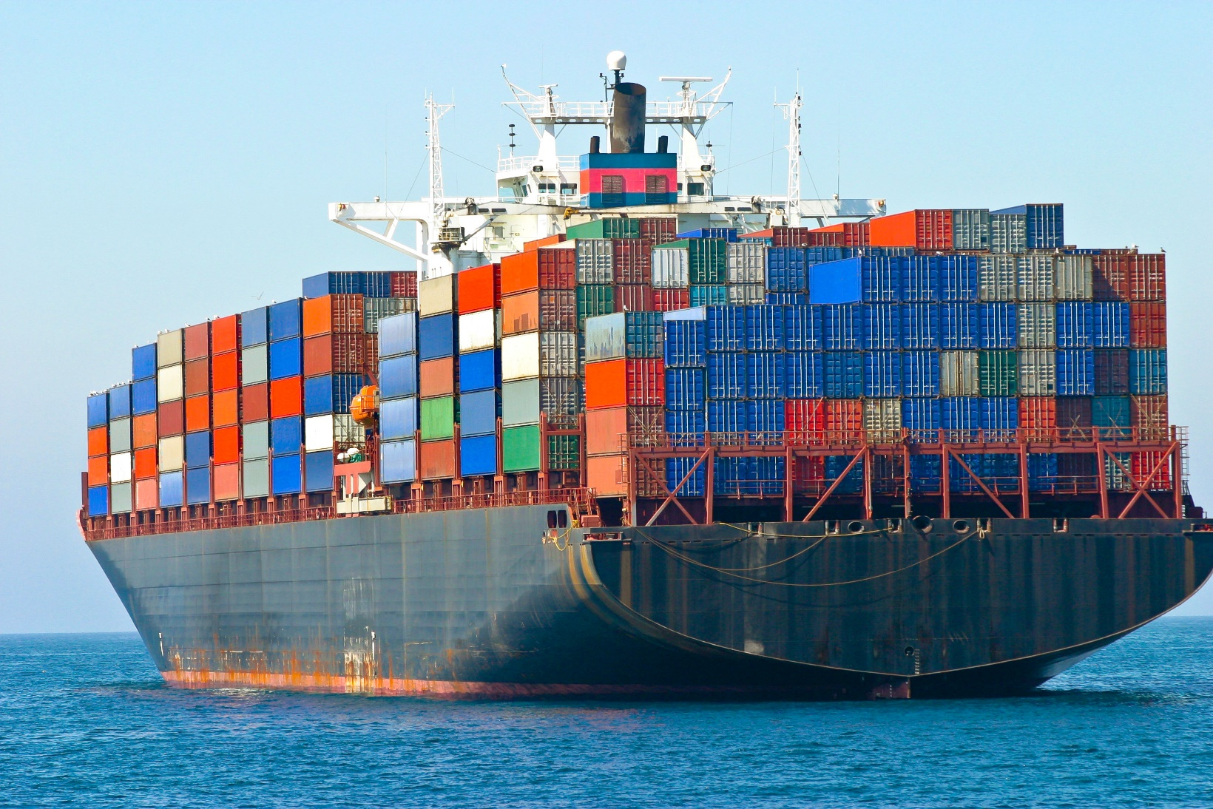
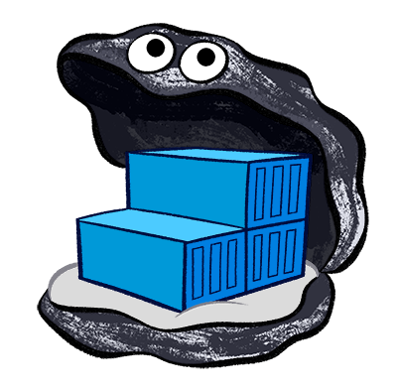
Docker HERO: Containerization for Software

Slide 6
So why Docker?
Containers are far from new;
Google has been using their own container technology for years.
Others Linux container technologies include
Solaris Zones,
BSD jails, and
LXC, which have been around for many years.
Docker is an open-source project based on Linux containers. It uses Linux Kernel features.

Slide 7
Docker Benefits
Local development environments can be set up that are exact replicas of a live environment/server.
It simplifies collaboration by allowing anyone to work on the same project with the same settings, irrespective of the local host environment.
Multiple development environments can be run from the same host each one having different configurations, operating systems, and software.
Projects can be tested on different servers.
It gives you instant application portability. Build, ship, and run any application as a portable container that can run almost anywhere.

Slide 8
Why Docker?
Ease of use. It allows anyone to package an application on their laptop, which in turn can run unmodified anywhere
The mantra is: “build once, run anywhere.”
Speed. Docker containers are very lightweight and fast. Since containers are just sandboxed environments running on the kernel, they take up fewer resources. You can create and run a Docker container in seconds, compared to VMs which might take longer because they have to boot up a full virtual operating system every time.
Docker Hub. Docker users also benefit from the increasingly rich ecosystem of Docker Hub, which you can think of as an “app store for Docker images.” Docker Hub has tens of thousands of public images created by the community that are readily available for use.
Modularity and Scalability. Docker makes it easy to break out your application’s functionality into individual containers. With Docker, it’s become easier to link containers together to create your application, making it easy to scale or update components independently in the future.

Slide 9
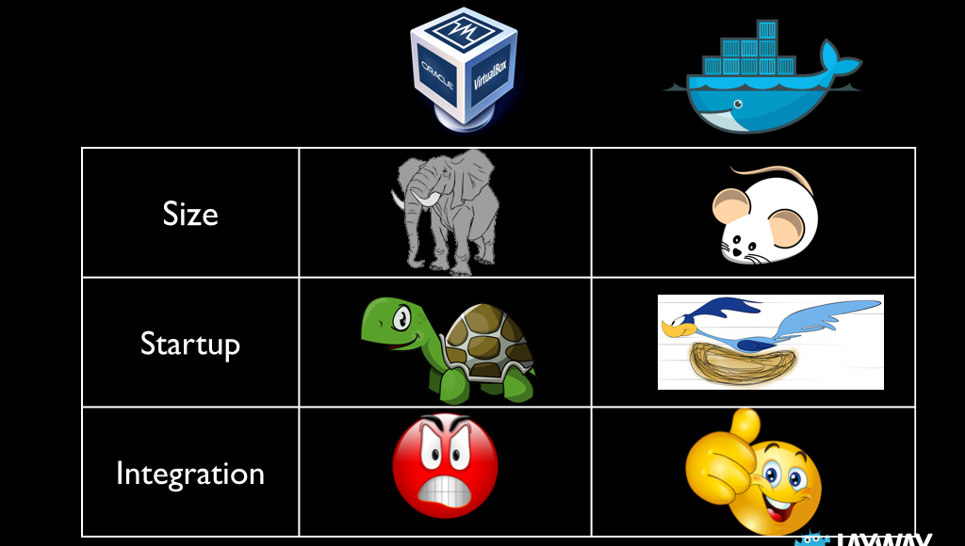
VM vs. Docker

Slide 10
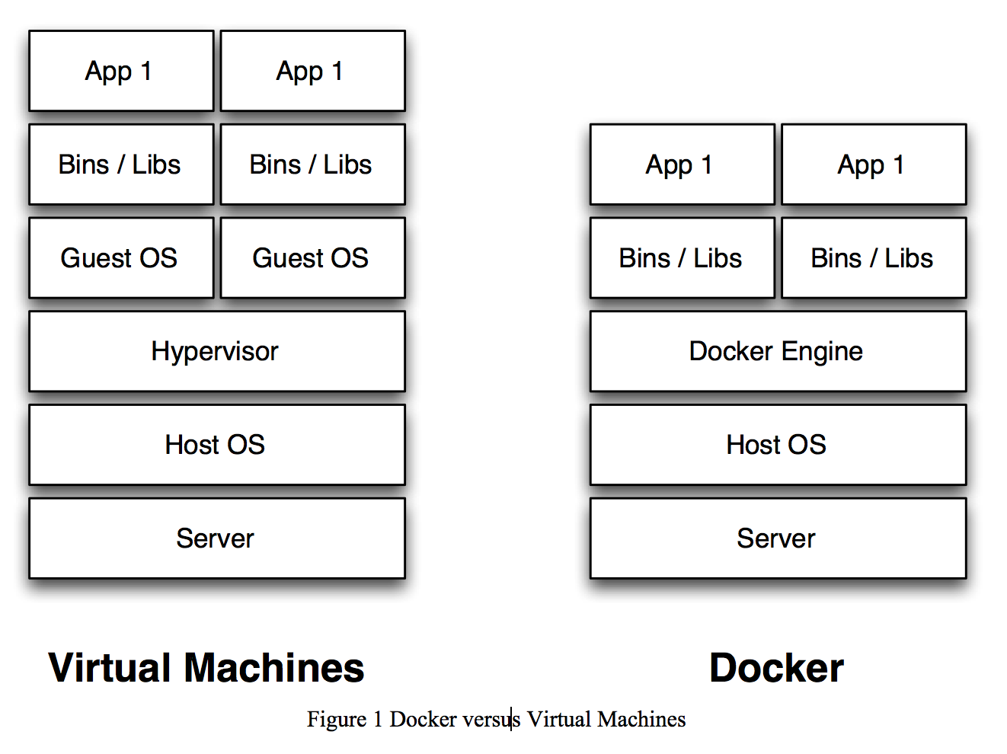
VM vs. Docker (Containers)
Docker Engine
Docker engine is the layer on which Docker runs.
It’s a lightweight runtime and tooling that manages containers, builds, and more.

